Slide 1


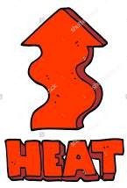



Slide 2


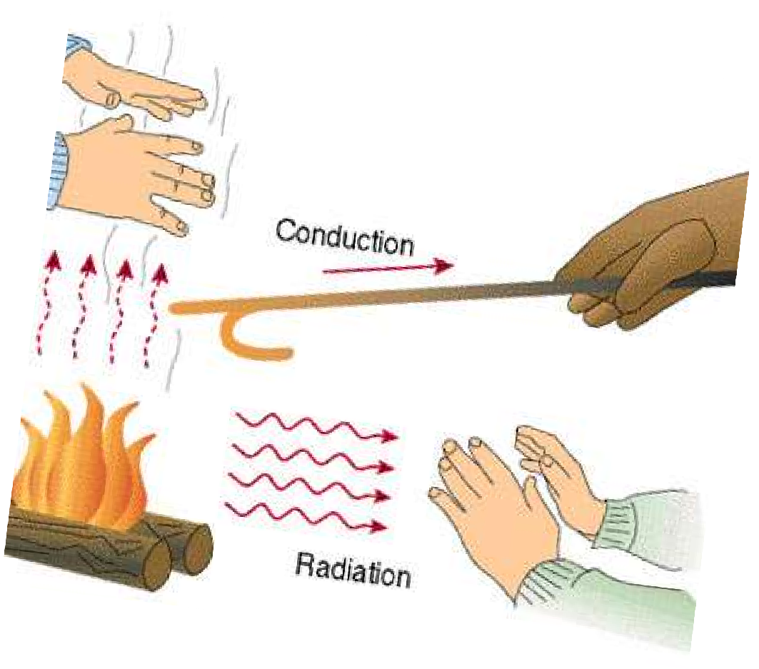



3 TYPES :
Conduction Convection Radiation

Slide 3



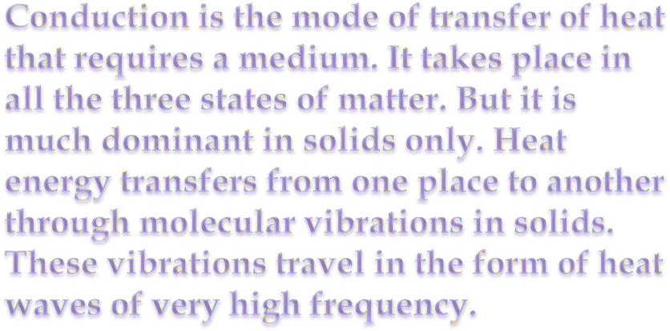
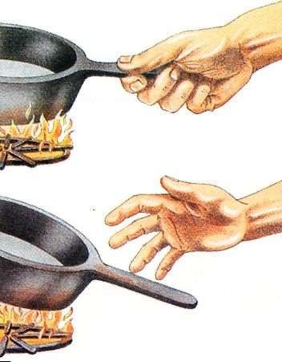


Slide 4

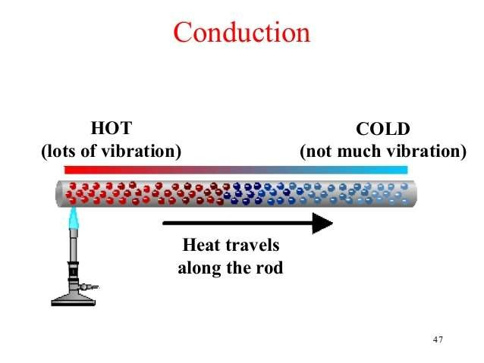

Slide 5


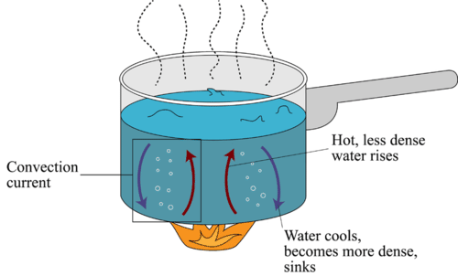
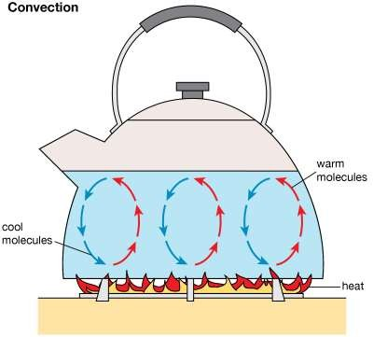
“In fluids (liquids or gases) heat transfer from one place to another inside a system takes place through convection. This mode of transfer of heat requires a material medium.”

Slide 6

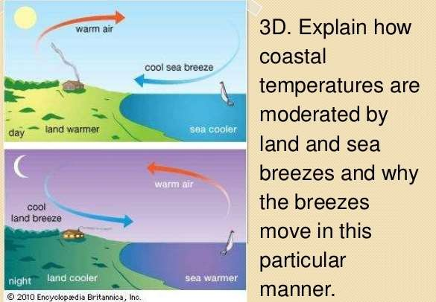

Slide 7

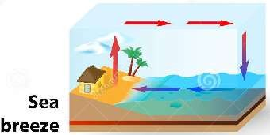
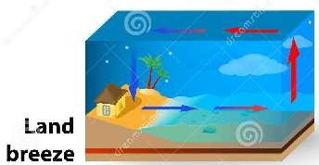
LAND BREEZES AND SEA BREEZES:
Land is better conductor of heat than water.Hence in day time, the land gets hotter than in the sea. The air above the land becomes warm and rises up being lighter and some what cold air above sea surface moves towards the sea shore. This is known as sea breeze.
During night land becomes cooler than water and so warm air over the water in sea rises up. The air on the land near the sea shore begins to move towards sea side and is called land breeze

Slide 8
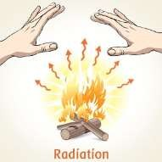
RADIATION
RADIATION :
“The process in which heat energy travels from one system to another in the form of electromagnetic waves with no need of material medium is called Radiation.”

Slide 9

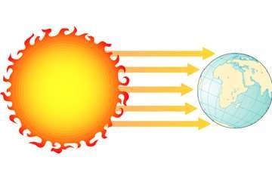
Heat from the sun reaches earth directly by radiation without any medium.

Slide 10



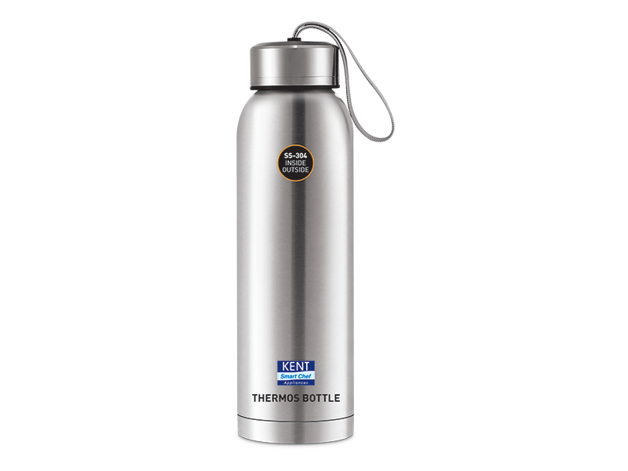
The vacuum flask consists of two flasks, placed one within the other and joined at the neck. The gap between the two flasks is partially evacuated of air, creating a near-vacuum which prevents heat transfer by conduction or convection. Heat transfer by thermal radiation may be minimized by silvering flask surfaces facing the gap. Most heat transfer occurs through the flask's neck and opening, where there is no vacuum. Vacuum flasks are commonly made of metal, glass, foam, or plastic, and have their opening stopper with plastic.

Slide 11
THANK YOU

